Slide 1
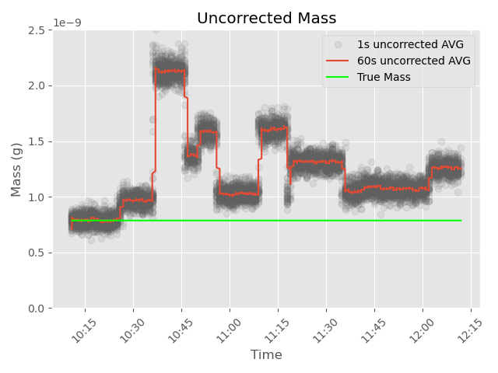
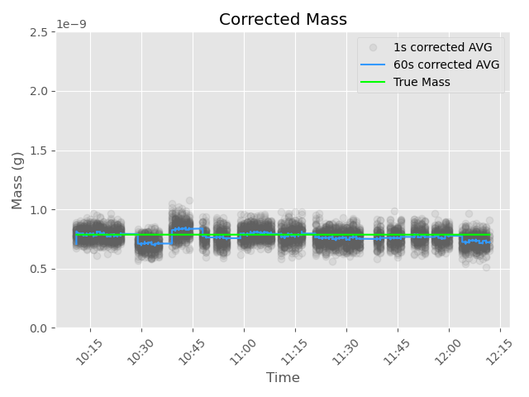
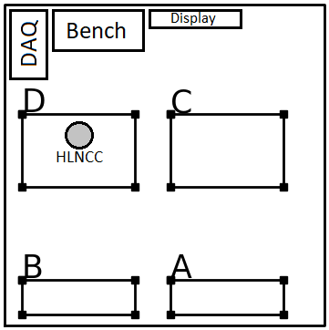
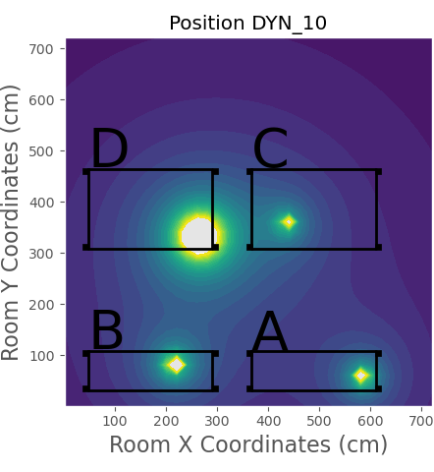
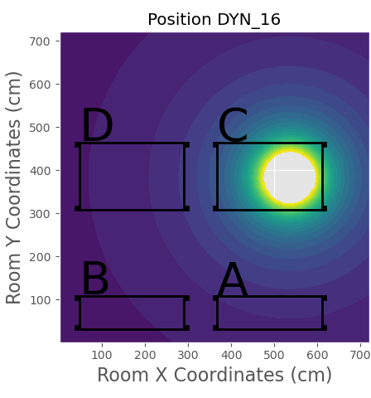
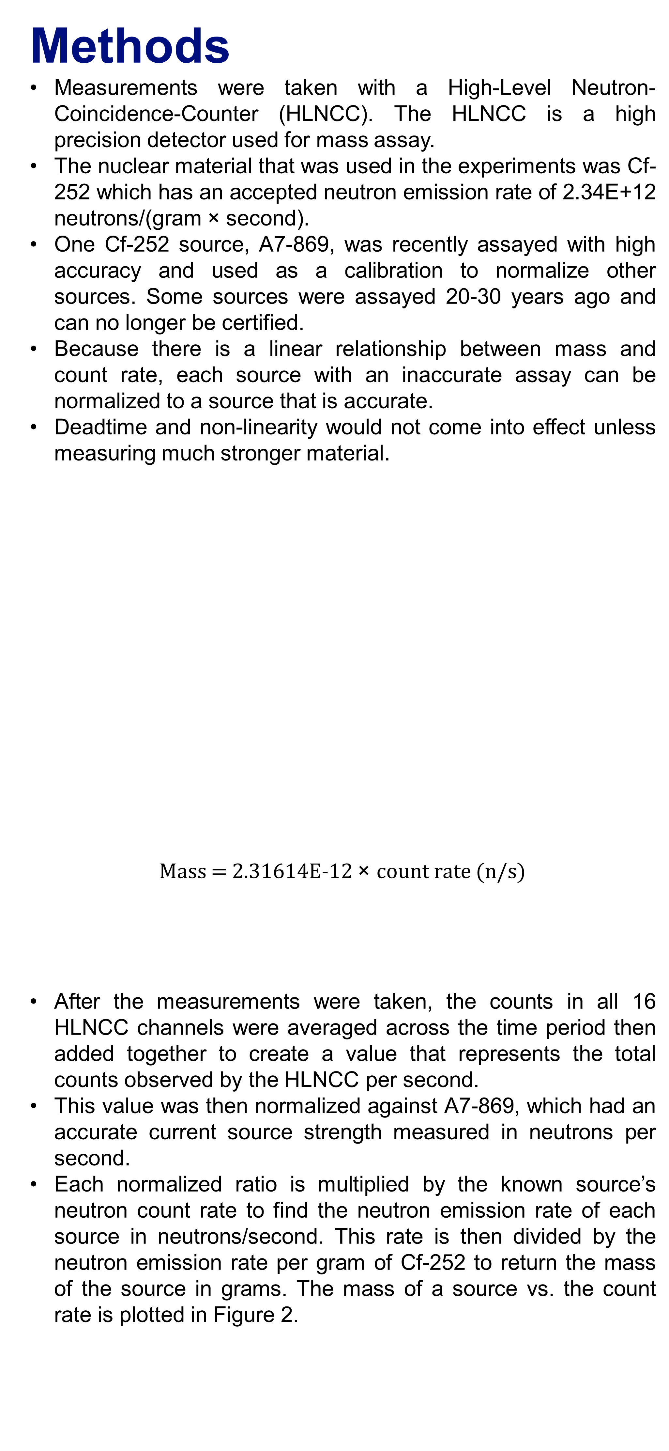
Algorithm for Mass Prediction of a Nuclear Source in a Dynamic Environment
Owen Pannucci^{1,2}; Danielle South^{1,3}; Thomas DeGuire^{1,3}; Tom Stockman¹; Rollin Lakis¹ | NEN-1 Safeguards Science and Technology, ¹Los Alamos National Laboratory, ²University of New Mexico, ³Texas A&M University
Background
To reduce the attribution of background in measurements, nuclear material is often transported from a working area into a shielded measurement area, reducing uncertainties.
This method is effective; however, material movement represents a significant contamination and exposure risk to operators.
This work aims to remove that step from the process and enable the use of high-precision instruments in an environment with a dynamic radiation background as seen in Figure 1.
The dynamic radiation background of a working area will be artificially removed, allowing for an accurate assay of a nuclear material source.
Multiple background sources with varying strengths can be compensated for with a data driven model.
Post compensation, an accurate measurement for corrected mass will be outputted.
Methods
Measurements were taken with a High-Level Neutron-Coincidence-Counter (HLNCC). The HLNCC is a high precision detector used for mass assay.
The nuclear material that was used in the experiments was Cf-252 which has an accepted neutron emission rate of 2.34E+12 neutrons/(gram × second).
One Cf-252 source, A7-869, was recently assayed with high accuracy and used as a calibration to normalize other sources. Some sources were assayed 20-30 years ago and can no longer be certified.
Because there is a linear relationship between mass and count rate, each source with an inaccurate assay can be normalized to a source that is accurate.
Deadtime and non-linearity would not come into effect unless measuring much stronger material.
Mass = 2.31614E-12 $\text{×}$count rate (n/s)
After the measurements were taken, the counts in all 16 HLNCC channels were averaged across the time period then added together to create a value that represents the total counts observed by the HLNCC per second.
This value was then normalized against A7-869, which had an accurate current source strength measured in neutrons per second.
Each normalized ratio is multiplied by the known source’s neutron count rate to find the neutron emission rate of each source in neutrons/second. This rate is then divided by the neutron emission rate per gram of Cf-252 to return the mass of the source in grams. The mass of a source vs. the count rate is plotted in Figure 2.
Figure 3. Uncorrected mass measurement with a dynamic background compared to the true mass of the source.
Figure 2. Normalized singles count rate vs. mass of the Cf-252 sources.
Figure 4. Mass measurement during the same dynamic background as in Figure 3 but corrected for source movement.
Conclusion
A data driven model was successfully created to reduce measurement uncertainties for a high value neutron detector in a dynamic radiation background environment. Figure 4. was generated using the data driven model to subtract the background seen in Figure 3.
The average uncorrected mass error was 56% and the newly developed correction method reduced that error to 2%. This is a factor of 28 improvement over conventional measurements.
Figure 1. Layout of testbed with simulated images of radiation sources used to replicate the effects of moving nuclear material that creates a dynamic radiation background for high performance measurement systems.
Acknowledgements
Thank you to the DYMAC LDRD for funding this research.
LA-UR# 22-27508

